Slide 1

Machine Learning App
Waleed Abokhamis

Slide 2
Introduction
Here you interact with Four different models and get different response based on your chosen model.
Sentiment Analysis Model
Text Generation Model
Text Generation Model
Image Classification Model

Slide 3
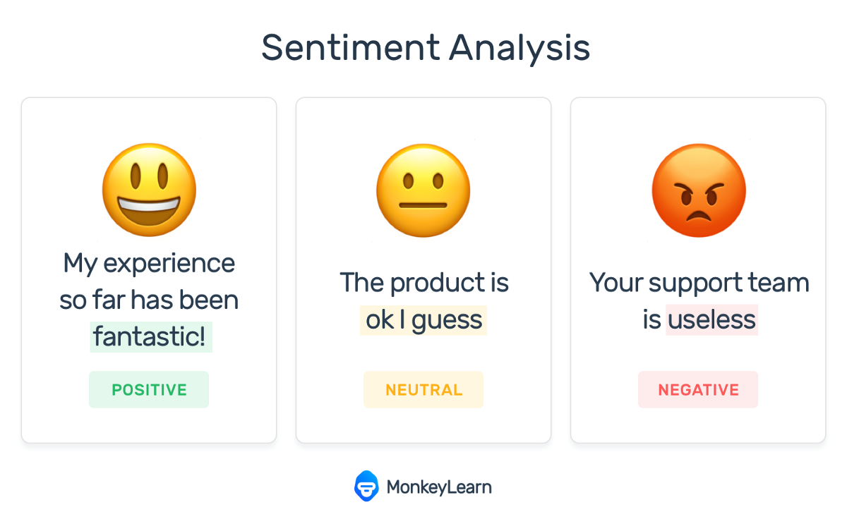
Sentiment Analysis Model
Python sentiment analysis is : a methodology for analyzing a piece of text to discover the sentiment hidden within it.

Slide 4
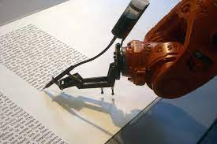
Text Generation Model
Text generation is the mechanism of producing new texts automatically by the neural network based on a huge corpus of texts

Slide 5

Question Answering Model
A question answering model is simply a computer program that answers the questions you ask.

Slide 6
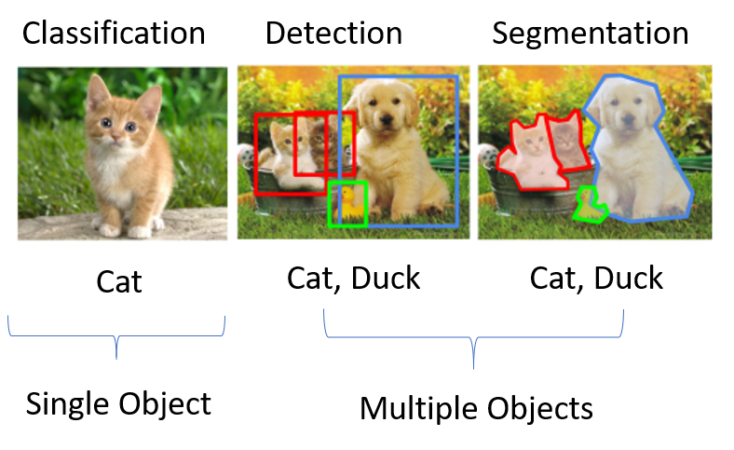
Image Classification Model
Image classification is a method to classify the images into their respective category classes

Slide 7
Sentiment_analysis Functions
def sentiment_analysis(response: str)-> str:
"""Sends a request to the Sentiment model.
def sentimental_analysis_sql_output():
""" This function collects data from all columns and returns all rows from table(sentiment_analysis).
This table is connected to the Sentiment-model.
def sentimental_analysis_sql_input(text_input, sentiment_output, score_output, validation):
"""Save the the data from the sentiment analysis model to a SQLite database, creates database and tables if needed.

Slide 8
Question_Answering Functions
def question_answering(response1: str, response2: str)-> str:
"""Sends a request to the QA-model.
def sql_output_qa():
This function collects data from all columns and returns all rows from table(question_answer).
This table is connected to the QA-model.
def sql_input_qa(context_input:str, question_input:str, answer_output:str, score_output: float):
"""Save the the data from the QA model to a SQLite databas, creates database and tables if needed.

Slide 9
Image Classifier Functions
def file_namer(img_name: str)->str:
"""Extracts the filename that was uploaded
def sql_image_input(img_name: str,result: str):
"""Save the the data from the Image_classifier model to a SQLite database, creates database and tables if needed.
def sql_img_output():
"""Collects all columns from table image_classifier.
def init_session_state_image_classifier():
""" This method initialize two session state variables.
cat: keeps track of any changes been made in categories. Only call API when its necessary
hide_upload_panel: if user put empty boxes in categories -> don't show upload widget
def labels_changer():
“””The image classifier are analysing an image against three categories(labels).

Slide 10
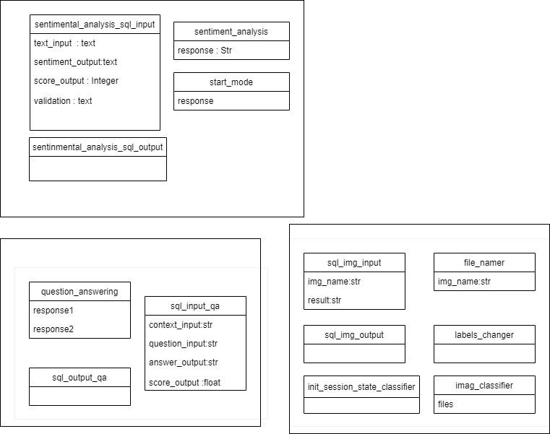

Slide 11


DataBase(SQLite)
We use of the Streamlite library. The idea at large was that the user uploads data into a database and the user can then reach the saved information that is sorted under the name of the applicant. The simple database used is SQLite
>> SQLite Features
Raw data can be imported from CSV files, then that data can be sliced and diced to generate a myriad of summary reports to analyze large datasets
SQLite does not have a separate server process. SQLite reads and writes directly to ordinary disk files
Possible uses include website log analysis, sports statistics analysis, compilation of programming metrics, and analysis of experimental results
SQLite is a compact library
Data Inside Database Has Types (Text , integer ,Data)

Slide 12
Create Database and Fetch Data
# Create Database And Connect
db = sqlite3.connect('database.db')
# Setting Up The Cursor
cur = db.cursor()
# Create The Tables and Field
cur.execute(" CREATE TABLE IF NOT EXISTS question_answer (input_time, context text, question text, answer text, score integer)")
# Inserting Data
cur.execute(" INSERT INTO question_answer VALUES (?,?,?,?,?)",data)
# Fetch Data From Database
df = pd.read_sql_query("SELECT * FROM question_answer", db)
# Save (Commit) Changes
db.commit()

Slide 13
Database Relationship
There is no relationship database between four models because every model works in a unique system
I think in Sentiment_analysis Model you can detect positive and negative with probability score
And the relationship one to many

Slide 14
API
A REST API (also known as RESTful API) is an application programming interface (API or web API) that conforms to the constraints of REST architectural style and allows for interaction with RESTful web services. REST stands for representational state transfer and RESTful web APIs are typically loosely based on HTTP methods to access resources via URL-encoded parameters and the use of JSON or XML to transmit data
A REST API leverages HTTP methods It uses the following requests:
GET : Fetch Data
PUT : Alter the state of data (such as an object, file, or block)
POST : Create data
DELETE : Methods to Eliminate it

Slide 15
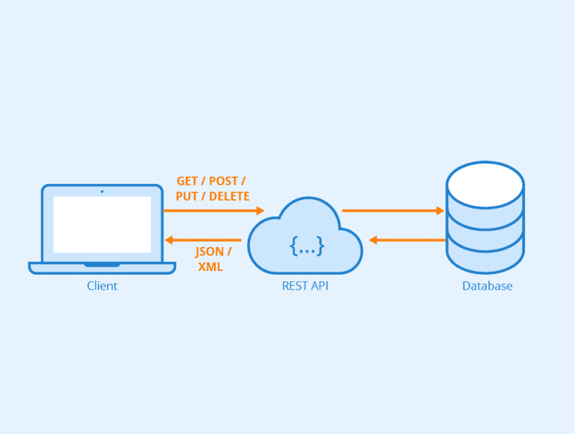
API Figure

Slide 16
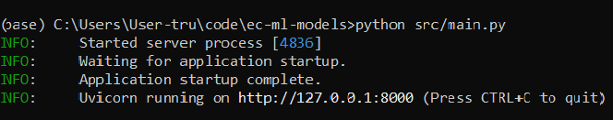
How API Works
# Start API
# Start Sentiment Analysis Model

Slide 17
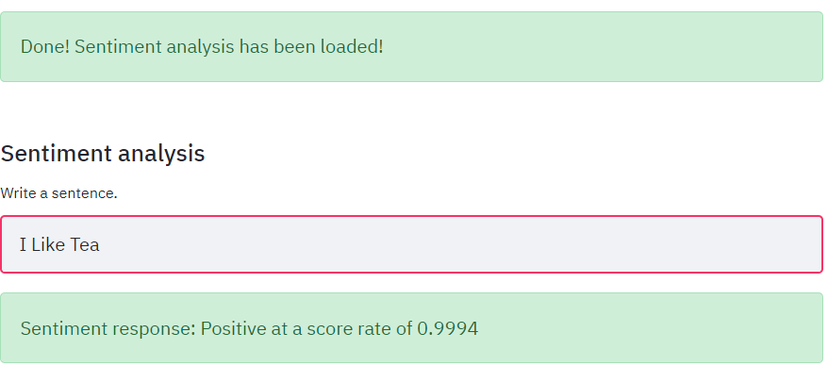
Sentiment Analysis
# Write sentence … Positive Score

Slide 18
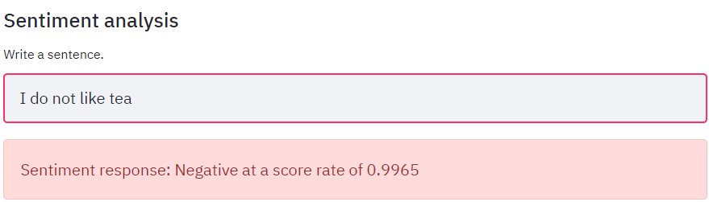
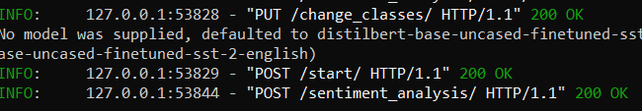
Sentiment Analysis
# Negative Score

Slide 19
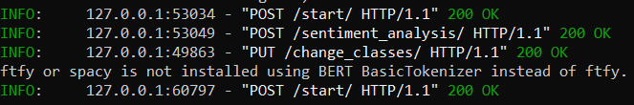
API Image Classifier Model
# Change Another Model

Slide 20
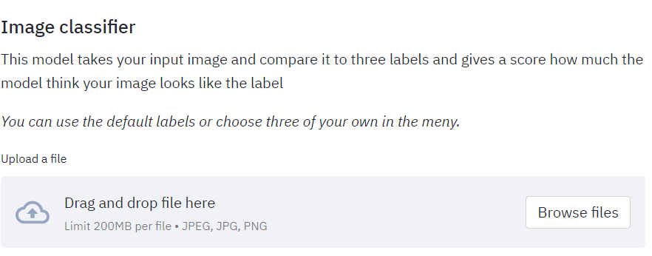
API Image Classifier Model
# Image Classifier

Slide 21
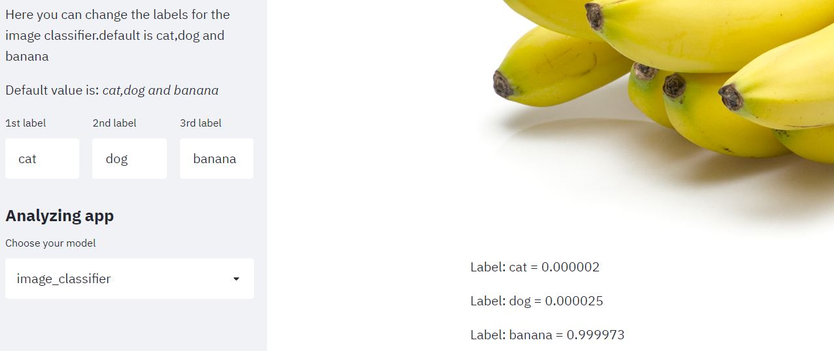
API Image Classifier Model

Slide 22
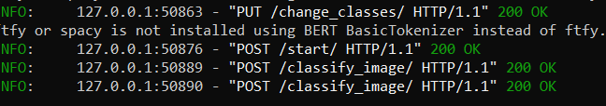
API Image Classifier Model
# Save Data

Slide 23
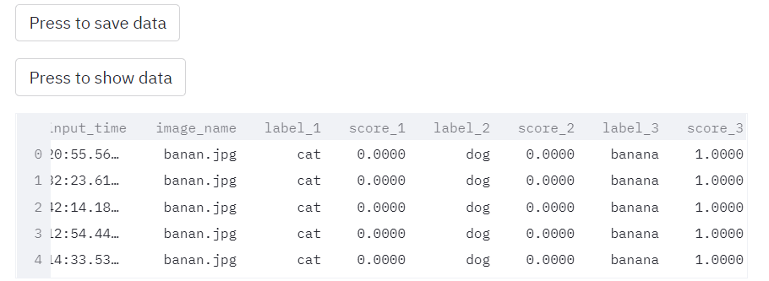
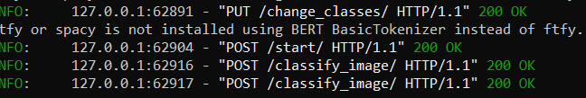
API Image Classifier Model
# Show data

Slide 24


